Slide 1
STOR 455 Class 22
Read: 4.1, 4.4
Exercises: 4.10, 12

Slide 2
Types of “Unusual” Points in SLM
Outlier: A data point that is far from the regression line.
Influential point: A data point that has a large effect on the regression fit.
How do we measure “far”?
How do we measure “effect on the fit”?

Slide 3
Detecting Unusual Cases - Overview
1. Compute residuals
“raw”, standardized, studentized
2. Plots of residuals (or std. residuals)
Boxplot, scatterplot, normal plot
3. Leverage
Unusual values for the predictors
4. Cook’s distance
Cases with large influence

Slide 4
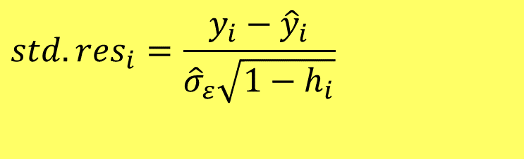
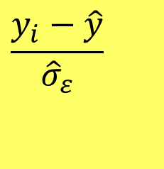

Standardized Residuals
For residuals: mean=0 and std. dev. $≈{\hat{σ}}_{ε}$
$$\frac{y_{i}−\hat{y}}{{\hat{σ}}_{ε}}$$
Look for values
beyond ±2 (mild) or beyond ±3
Standardized Residual ≈
(almost)
Definition: The standardized residuals are:
$$std.res_{i}=\frac{y_{i}−{\hat{y}}_{i}}{{\hat{σ}}_{ε}\sqrt{1−h_{i}}}$$
Leverage

Slide 5
Studentized Residuals
Definition: The studentized residuals are:
Using model fit without i^{th} case

Slide 6
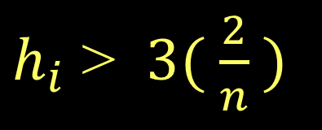
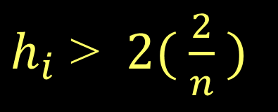
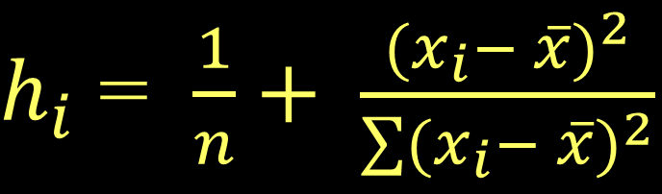
Leverage in Simple Linear Regression
$h_{i}$ = $\frac{1}{n}+ \frac{{(x_{i}− \overline{x})}^{2}}{\sum{{(x_{i}− \overline{x})}^{2}}}$
For a simple linear model:
= 1+ 1 = 2
Look for:
$h_{i}$ > $2( \frac{2}{n} )$
or
$h_{i}$ > $3( \frac{2}{n} )$

Slide 7
Leverage in Multiple Regression
For a multiple regression with k predictors:
Look for:
or

Slide 8

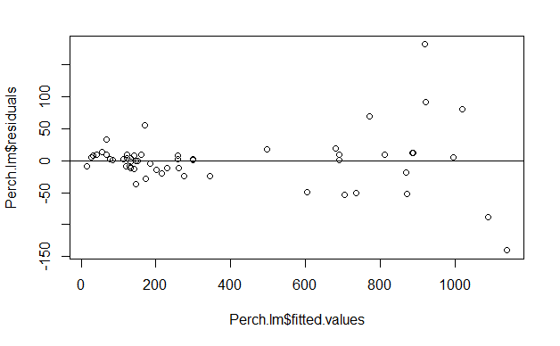
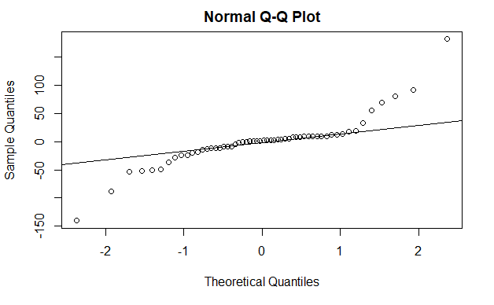
Leverage in Multiple Regression: Perch
Perch_lm = lm(Weight~Length+Width+Width*Length, data=Perch)
plot(Perch_lm$residuals~Perch_lm$fitted.values)
abline(0,0)

Slide 9
Leverage in Multiple Regression: Perch
2*(3+1)/56
3*(3+1)/56
head(sort(hatvalues(Perch_lm), decreasing=TRUE), n=8)
[1] 0.1428571
[1] 0.2142857
1 40 2 55 56 46 52
0.4313620 0.3628595 0.1529084 0.1509016 0.1434099 0.1396390 0.1205529
54
0.1124513

Slide 10
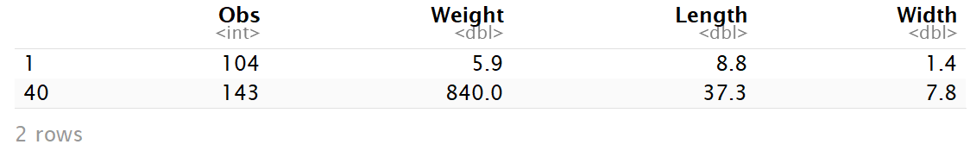
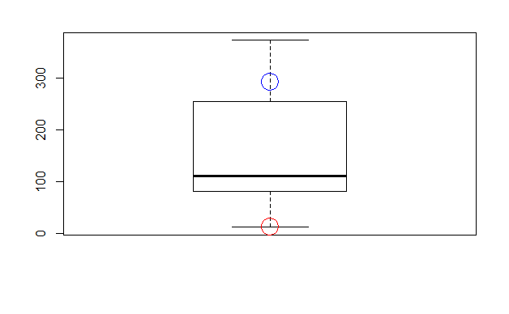
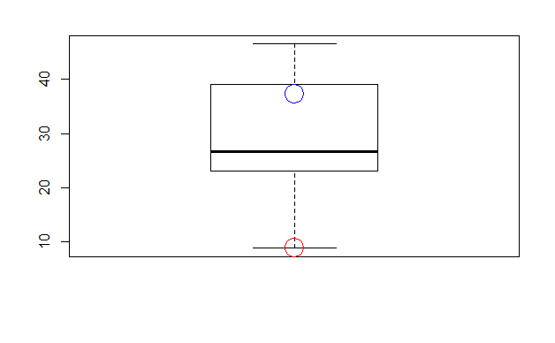
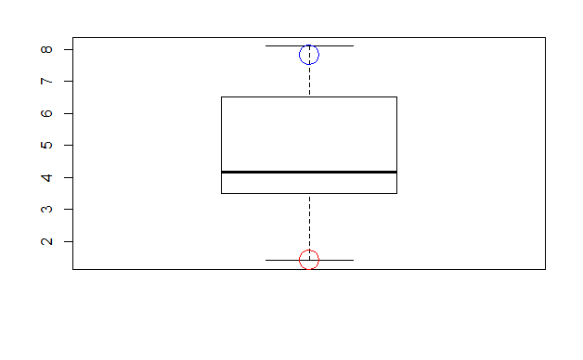
Leverage in Multiple Regression: Perch
Perch[c(1,40),]
boxplot(Perch$Length*Perch$Width, main="Length*Width")
points(Perch$Length[1]*Perch$Width[1], col="red", cex=3)
points(Perch$Length[40]*Perch$Width[40], col="blue", cex=3)
boxplot(Perch$Length, main="Length")
points(Perch$Length[1], col="red", cex=3)
points(Perch$Length[40], col="blue", cex=3)
boxplot(Perch$Width, main="Width")
points(Perch$Width[1], col="red", cex=3)
points(Perch$Width[40], col="blue", cex=3))

Slide 11
Cook’s Distance
How much would the fit change if one data value were omitted?
D_{i} increases with either poor fit (std.res_{i}) and high leverage (h_{i}).
Compare to other D_{i}’s.
Study any case with D_{i} > 0.5; worry if D_{i} > 1.0.

Slide 12
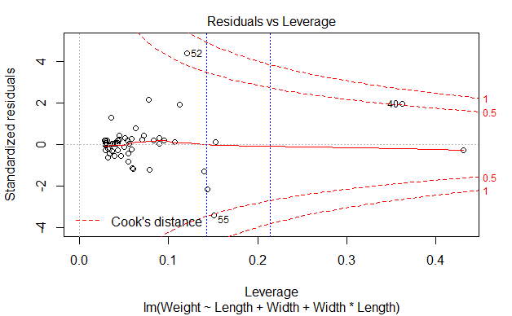
Cook’s Distance
plot(Perch_lm)
abline(v = 2*(3+1)/56, col="blue", lty=3)
abline(v = 3*(3+1)/56, col="blue", lty=3)

Slide 13
Houses
Response variable: Y = House price
Predictors: X₁ = Size; X₂ = Lot (size of the lot)

Slide 14
Fitting the Multiple Regression Model
Coefficients:
Estimate Std. Error t value Pr(>|t|)
(Intercept) 34121.649 29716.458 1.148 0.2668
Size 23.232 17.700 1.313 0.2068
Lot 5.657 3.075 1.839 0.0834 .
---
Signif. codes: 0 ‘***’ 0.001 ‘**’ 0.01 ‘*’ 0.05 ‘.’ 0.1 ‘ ’ 1
Residual standard error: 47400 on 17 degrees of freedom
Multiple R-squared: 0.5571, Adjusted R-squared: 0.505
F-statistic: 10.69 on 2 and 17 DF, p-value: 0.000985
How should we think about these coefficients?
Notes:
multregmodel=lm(Price~Size+Lot)
summary(multregmodel)

Slide 15
Added Variable Plot
Basic idea: For any single predictor Z …
1. Fit a model for Y using all other predictors. Save residuals as error1 (what the other predictors don’t know about Y).
2. Fit a model for Z using all other predictors. Save residuals as error2 (what the other predictors don’t know about Z).
3. Plot error1 vs. error2 (what’s unique to Z that explains new variability in Y).

Slide 16
The residuals from this model—PrLot.lm —are saved as PrLot.lm$resid
The residuals from this model— SizeLot.lm —are saved as SizeLot.lm$resid

Slide 17
Plot PrLot.lm$resid vs. SizeLot.lm$resid
Is there a relationship?
Equation of the line:
Coefficients:
Estimate Std. Error t value Pr(>|t|)
(Intercept) 34121.649 29716.458 1.148 0.2668
Size 23.232 17.700 1.313 0.2068
Lot 5.657 3.075 1.839 0.0834 .
---
Residual standard error: 47400 on 17 degrees of freedom
Multiple R-squared: 0.5571, Adjusted R-squared: 0.505
F-statistic: 10.69 on 2 and 17 DF, p-value: 0.000985
Familiar?!

Slide 18
Pulse: More than Two Predictors
Response variable: Y = Active pulse
Predictors: X₁ = Resting pulse
X₂ = Hgt
X₃ = Sex (0 = M, 1 = F)
Data: Pulse.csv

Slide 19
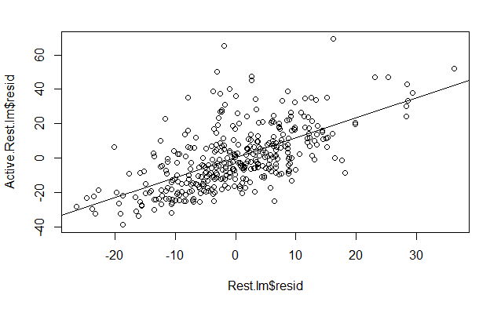
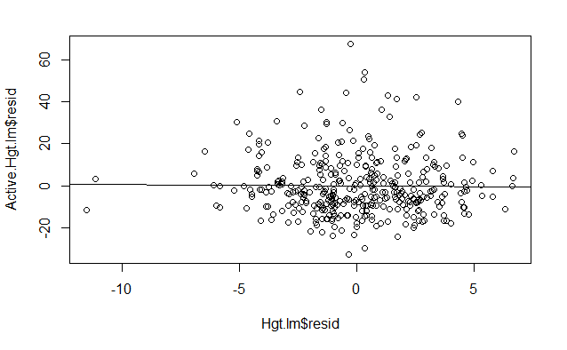
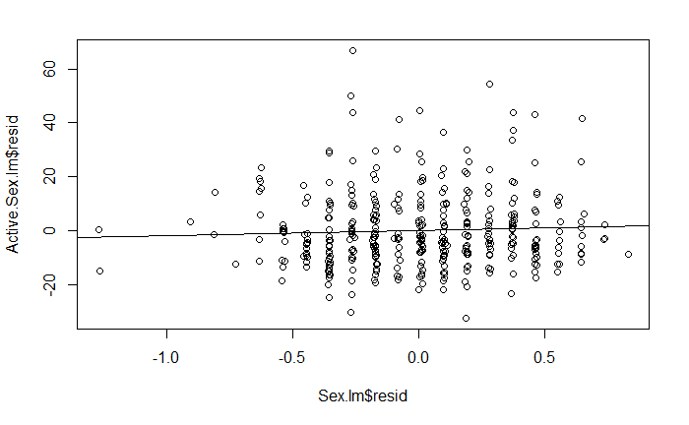
Pulse: More than Two Predictors
Active.Rest.lm = lm(Active~Hgt+Sex, data=Pulse)
Rest.lm = lm(Rest~Hgt+Sex, data = Pulse)
plot(Active.Rest.lm$resid~Rest.lm$resid)
mod1 = lm(Active.Rest.lm$resid~Rest.lm$resid)
abline(mod1)
summary(mod1)
Active.Hgt.lm = lm(Active~Rest+Sex, data=Pulse)
Hgt.lm = lm(Hgt~Rest+Sex, data = Pulse)
plot(Active.Hgt.lm$resid~Hgt.lm$resid)
mod2 = lm(Active.Hgt.lm$resid~Hgt.lm$resid)
abline(mod2)
summary(mod2)
Active.Sex.lm = lm(Active~Rest+Hgt, data=Pulse)
Sex.lm = lm(Sex~Rest+Hgt, data = Pulse)
plot(Active.Sex.lm$resid~Sex.lm$resid)
mod3 = lm(Active.Sex.lm$resid~Sex.lm$resid)
abline(mod3)
summary(mod3)

Slide 20
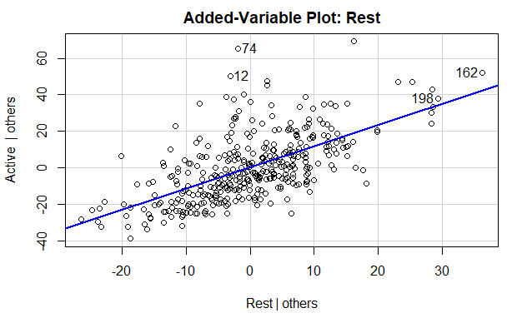
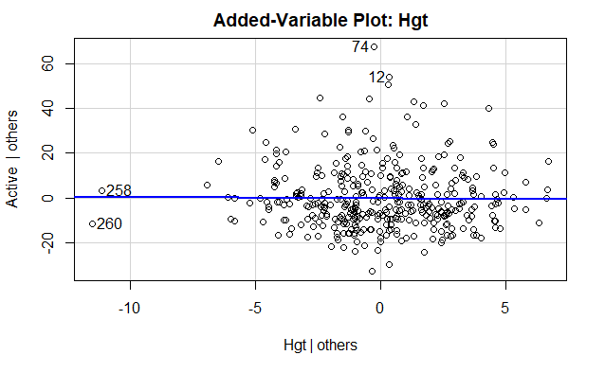
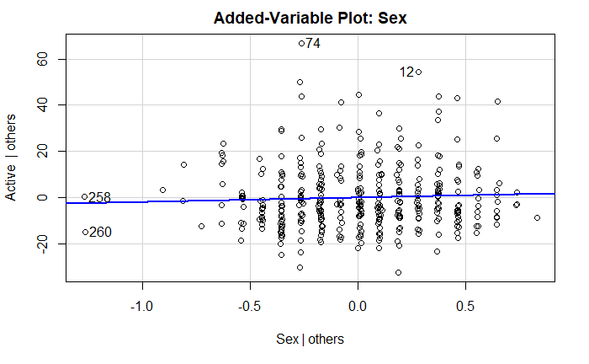
Added Variable Plots
library(car)
avPlot(Pulse.lm, “Rest”)
avPlot(Pulse.lm, “Hgt”)
avPlot(Pulse.lm, “Sex”)

Slide 21
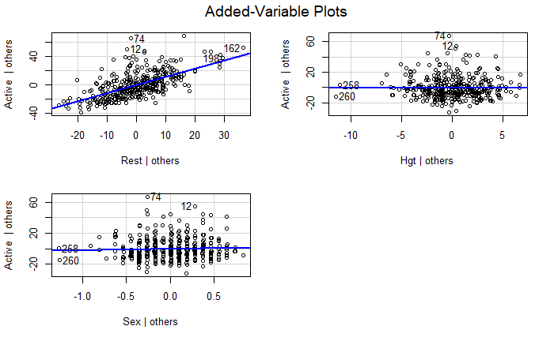
Added Variable Plots
avPlots(Pulse.lm, ~.)

Slide 22
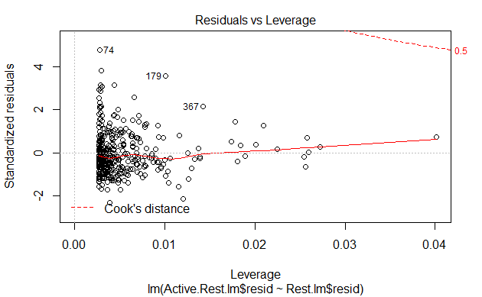
Pulse: More than Two Predictors
Active.Rest.lm = lm(Active~Hgt+Sex, data=Pulse)
Rest.lm = lm(Rest~Hgt+Sex, data = Pulse)
plot(Active.Rest.lm$resid~Rest.lm$resid)
mod1 = lm(Active.Rest.lm$resid~Rest.lm$resid)
abline(mod1)
summary(mod1)

Slide 23
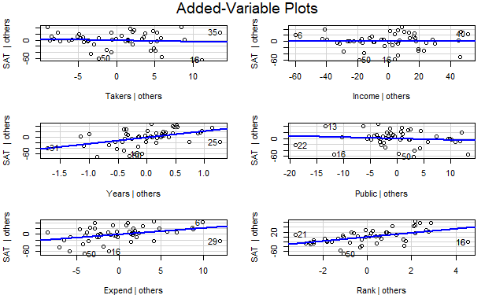
StateSAT: More than Two Predictors
StateSAT.lm = lm(SAT~., data=StateSAT[,c(2:8)])
avPlots(StateSAT.lm, ~.)

Slide 24
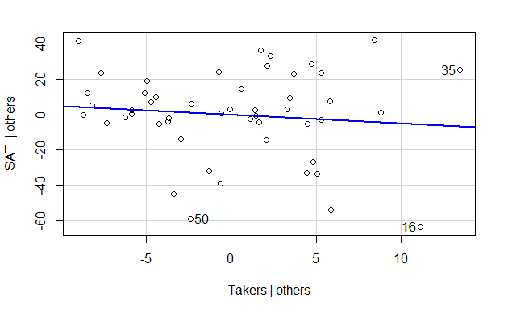
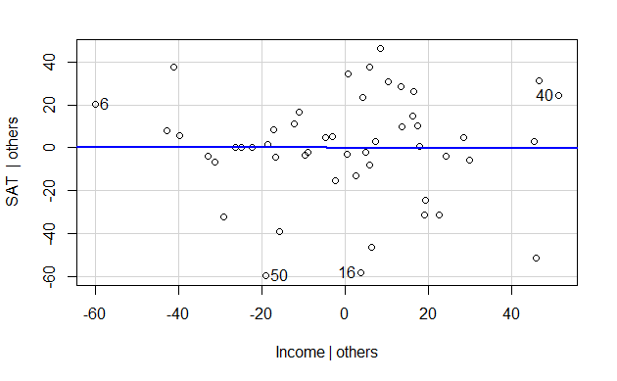
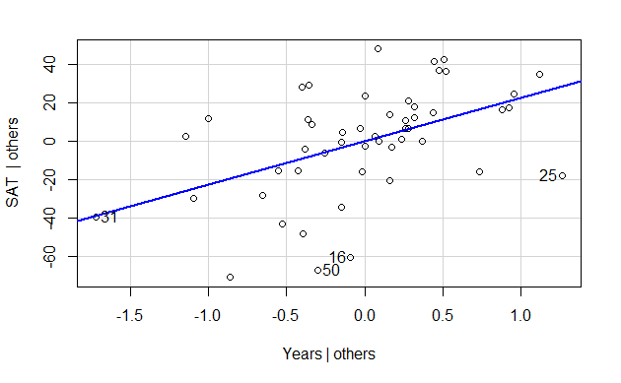
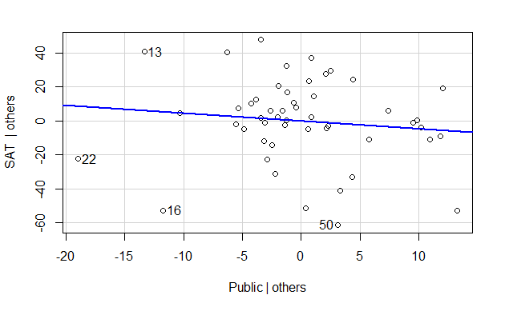
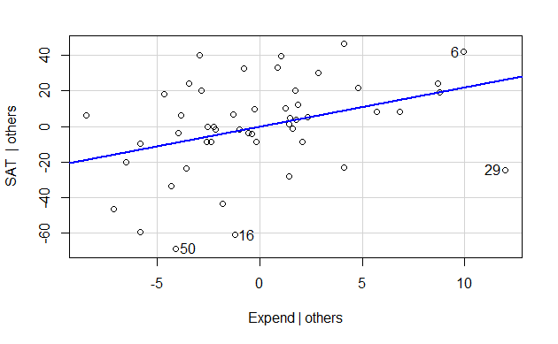
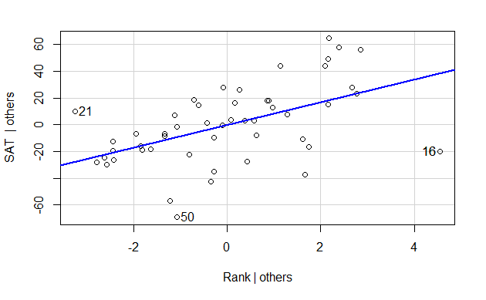
StateSAT: More than Two Predictors
variables = colnames(StateSAT)
for(i in 3:8){
avPlots(StateSAT.lm, variables[i])
}

